Slide 1
(IMDCGD214-16YRD) Level 4/5 Group 15
Elliot Page Ben Reynolds Roberto Mitrea

Slide 2
Brief
For 2 players
Physics based
Adversarial
(i.e. “...characterised by conflict or opposition” – Oxford Dictionary)
On a single device
(i.e. No hidden information)

Slide 3
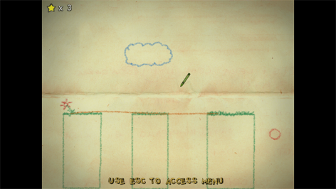
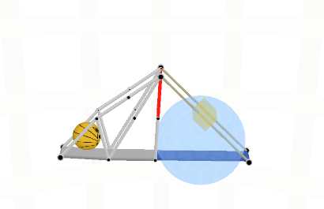
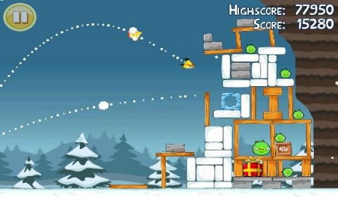
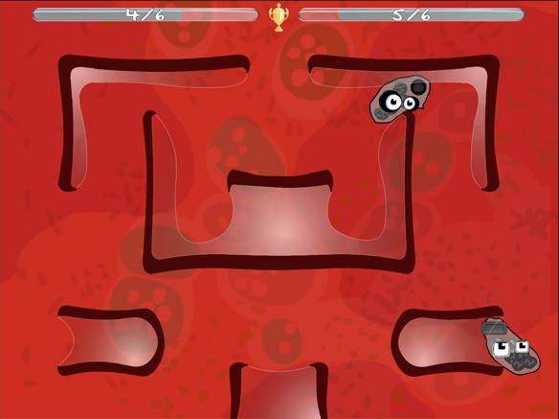
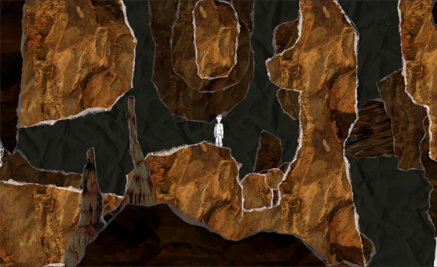
Research

Slide 4
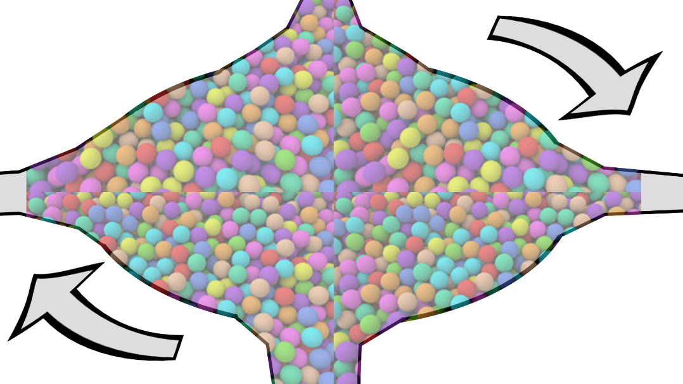
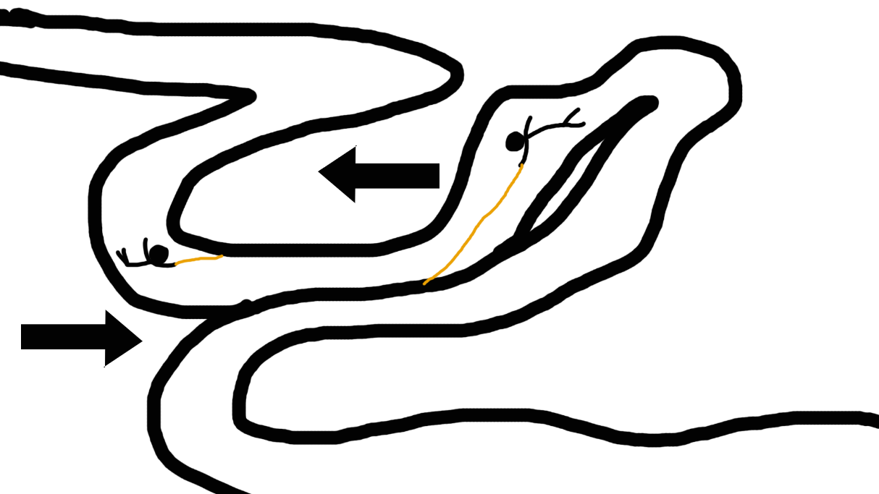
Discarded Prototypes

Slide 5
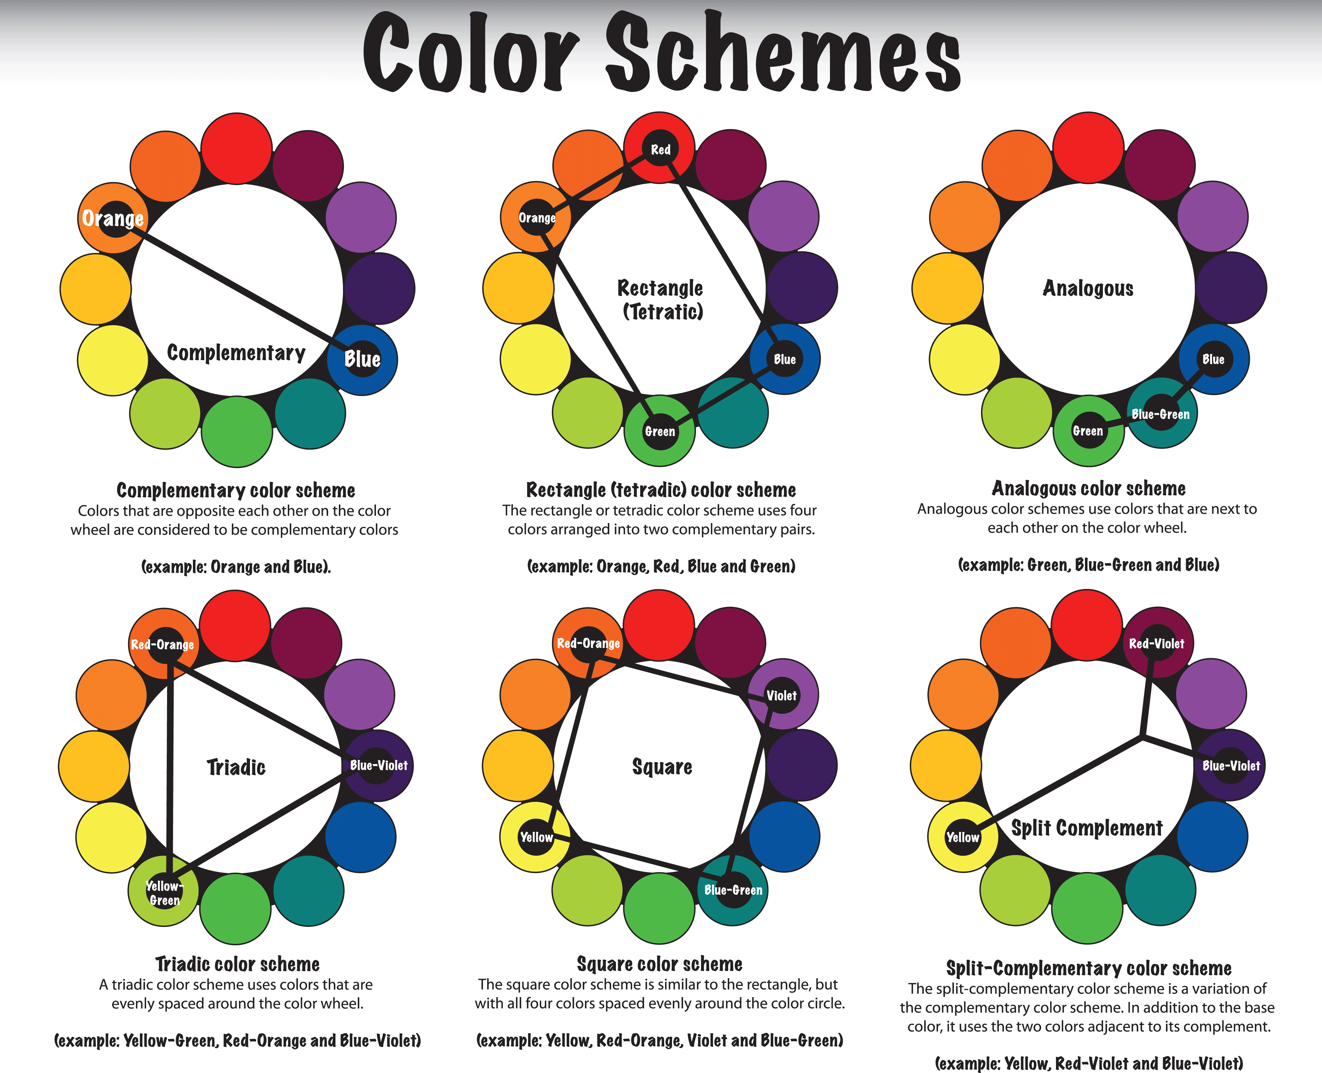
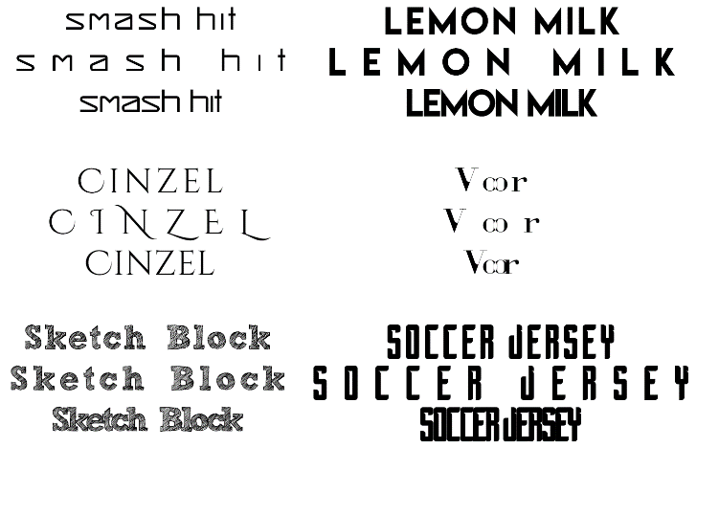
Research
Demographic: Males, 18-24

Slide 6

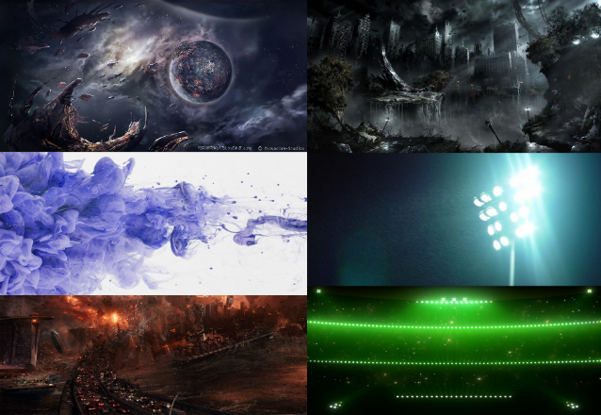


Research

Slide 7
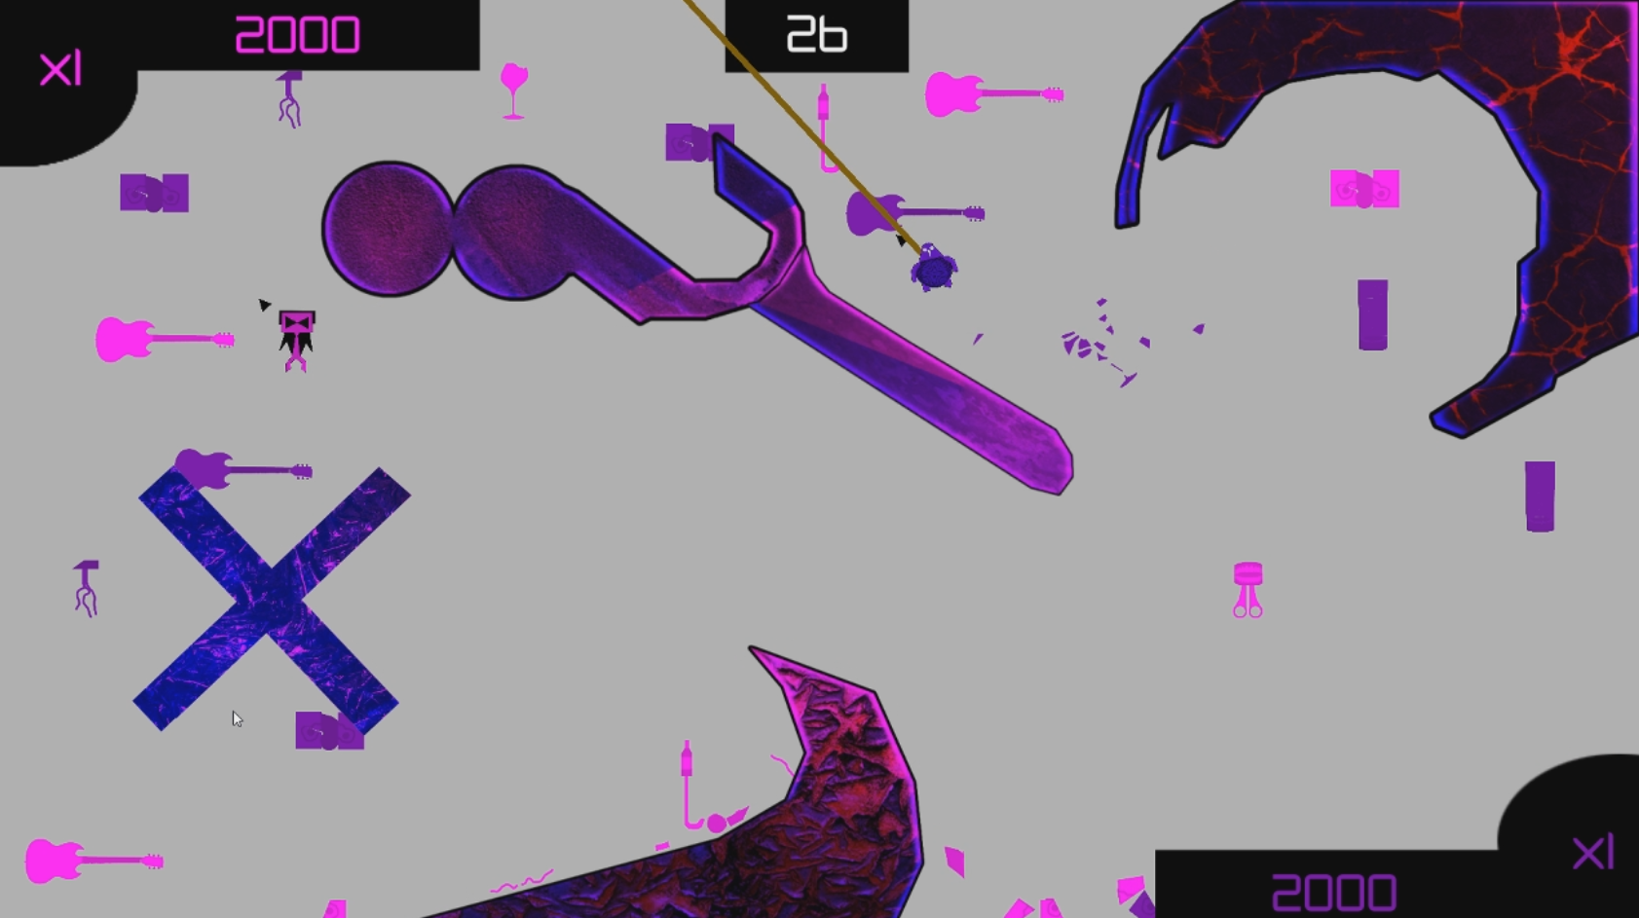
Our Game

Slide 8
Core Mechanic
Twitch Movement
Aiming the grapple hook
Navigating the environment

Slide 9
What The Player Does
Controls
Axis Movement
Gameplay
Destroy items to increase score
Player with the highest score at the end of the round wins

Slide 10
Prototype
https://youtu.be/IT4Zyvf0xQU

Slide 11
Playtesting
Volunteers, males, 18-22 years old
“I got stuck in the bottom left”
“I can’t see the arrow”
“It’s hard to differentiate between the items”
“The game is too short”

Slide 12
Next Steps
Add sounds
Adjust the colour palette
Redesign affordances
Bug fixing

Slide 13
Feedback/Questions?

